Slide 1
Lecture 2
Image File Format and Color Model

Slide 2
Image file format
Image file formats are standardized ways of encoding and storing digital images on a computer or other devices.
Each image file format has its own characteristics, including compression methods, color depth, transparency support, and compatibility with different platforms and software.

Slide 3
Some common image file formats:
JPEG (Joint Photographic Experts Group)
PNG (Portable Network Graphics)
GIF (Graphics Interchange Format)
BMP (Bitmap)
TIFF (Tagged Image File Format)
WebP (Web Picture)
HEIF (High-Efficiency Image File Format)

Slide 4
JPEG (Joint Photographic Experts Group):
JPEG is a widely used lossy compression format that is best suited for photographs and natural scenes.
It reduces file sizes by discarding some image details, which can result in a slight loss of image quality.
However, the compression is adjustable, allowing users to balance between file size and image quality.
File Extension: .jpg, .jpeg

Slide 5
PNG (Portable Network Graphics):
PNG is a lossless compression format that supports transparency, making it suitable for images with sharp edges, line drawings, and images requiring a transparent background.
PNG files are larger than JPEG files but retain higher image quality and do not introduce artifacts due to compression.
File Extension: .png

Slide 6
GIF (Graphics Interchange Format):
GIF is a lossless compression format primarily used for animated images (animated GIFs) and simple graphics.
It supports animation by combining multiple frames into a single file and is limited to 256 colors, which makes it less suitable for complex images.
File Extension: .gif

Slide 7
BMP (Bitmap):
BMP is a straightforward format that stores images pixel by pixel without compression.
It results in large file sizes and is not commonly used due to its lack of compression and wide compatibility issues.
File Extension: .bmp

Slide 8
TIFF (Tagged Image File Format):
TIFF is a versatile format that supports lossless compression and multiple color spaces.
It is commonly used in professional settings, such as printing and publishing, where high-quality images and preservation of image details are crucial.
File Extension: .tiff, .tif

Slide 9
WebP (Web Picture):
WebP is a modern image format developed by Google that provides both lossy and lossless compression.
It is designed to be web-friendly, offering smaller file sizes compared to JPEG and PNG without significant loss of image quality.
File Extension: .webp

Slide 10
HEIF (High-Efficiency Image File Format):
HEIF is a highly efficient image format that provides better compression than traditional formats like JPEG.
It supports both images and videos and is becoming increasingly popular on mobile devices.
File Extension: .heic, .heif

Slide 11
Quiz Time
1. Which image file format supports transparency, making it suitable for images with irregular shapes or backgrounds?
a) JPEG
b) PNG
c) GIF
d) TIFF
2. images pixel by pixel without compression are stored in:
a) PNG
b) Bitmap
c) GIF
d) TIFF

Slide 12
Answers:
1. Which image file format supports transparency, making it suitable for images with irregular shapes or backgrounds?
a) JPEG
b) PNG
c) GIF
d) TIFF
2. images pixel by pixel without compression are stored in:
a) PNG
b) GIF
c) Bitmap
d) TIFF

Slide 13
Color Model

Slide 14
A color model is a system used to describe a color. Different types of color models are used in multiple fields like in hardware, in multiple applications of creating animation, etc.
RGB
CMYK
HSV
YIQ

Slide 15
Before discussing different color models let us discuss types of color model.
Types of color model:
Additive Color Model
Subtractive Color Model

Slide 16
Additive Color Model
These type of models use light which is emitted directly from a source to display colors.
These models mixes different amount of RED, GREEN, and BLUE (primary colors) light to produce rest of the colors.
Adding these three primary colors results in WHITE image.
Example: RGB model is used for digital displays such as laptops, TVs, tablets, etc.

Slide 17
Subtractive Color Model
These type of models use printing inks to display colors.
Subtractive color starts with an object that reflects light and uses colorants to subtract portions of the white light illuminating an object to produce other colors.
If an object reflects all the white light back to the viewer, it appears white, and if it absorbs all the light then it appears black.
Example: Graphic designers used the CMYK model for printing purpose.

Slide 18
RGB Model:
The RGB color model is an additive color model.
The RGB color model is one of the most widely used color representation method in computer graphics. It use a color coordinate system with three primary colors:
R(red), G(green), B(blue)
Each primary color can take an intensity value ranging from 0(lowest) to 1(highest). Mixing these three primary colors at different intensity levels produces a variety of colors.

Slide 19
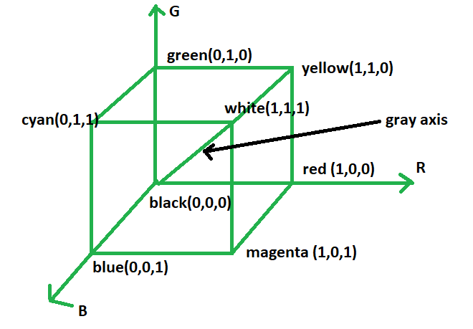

Slide 20
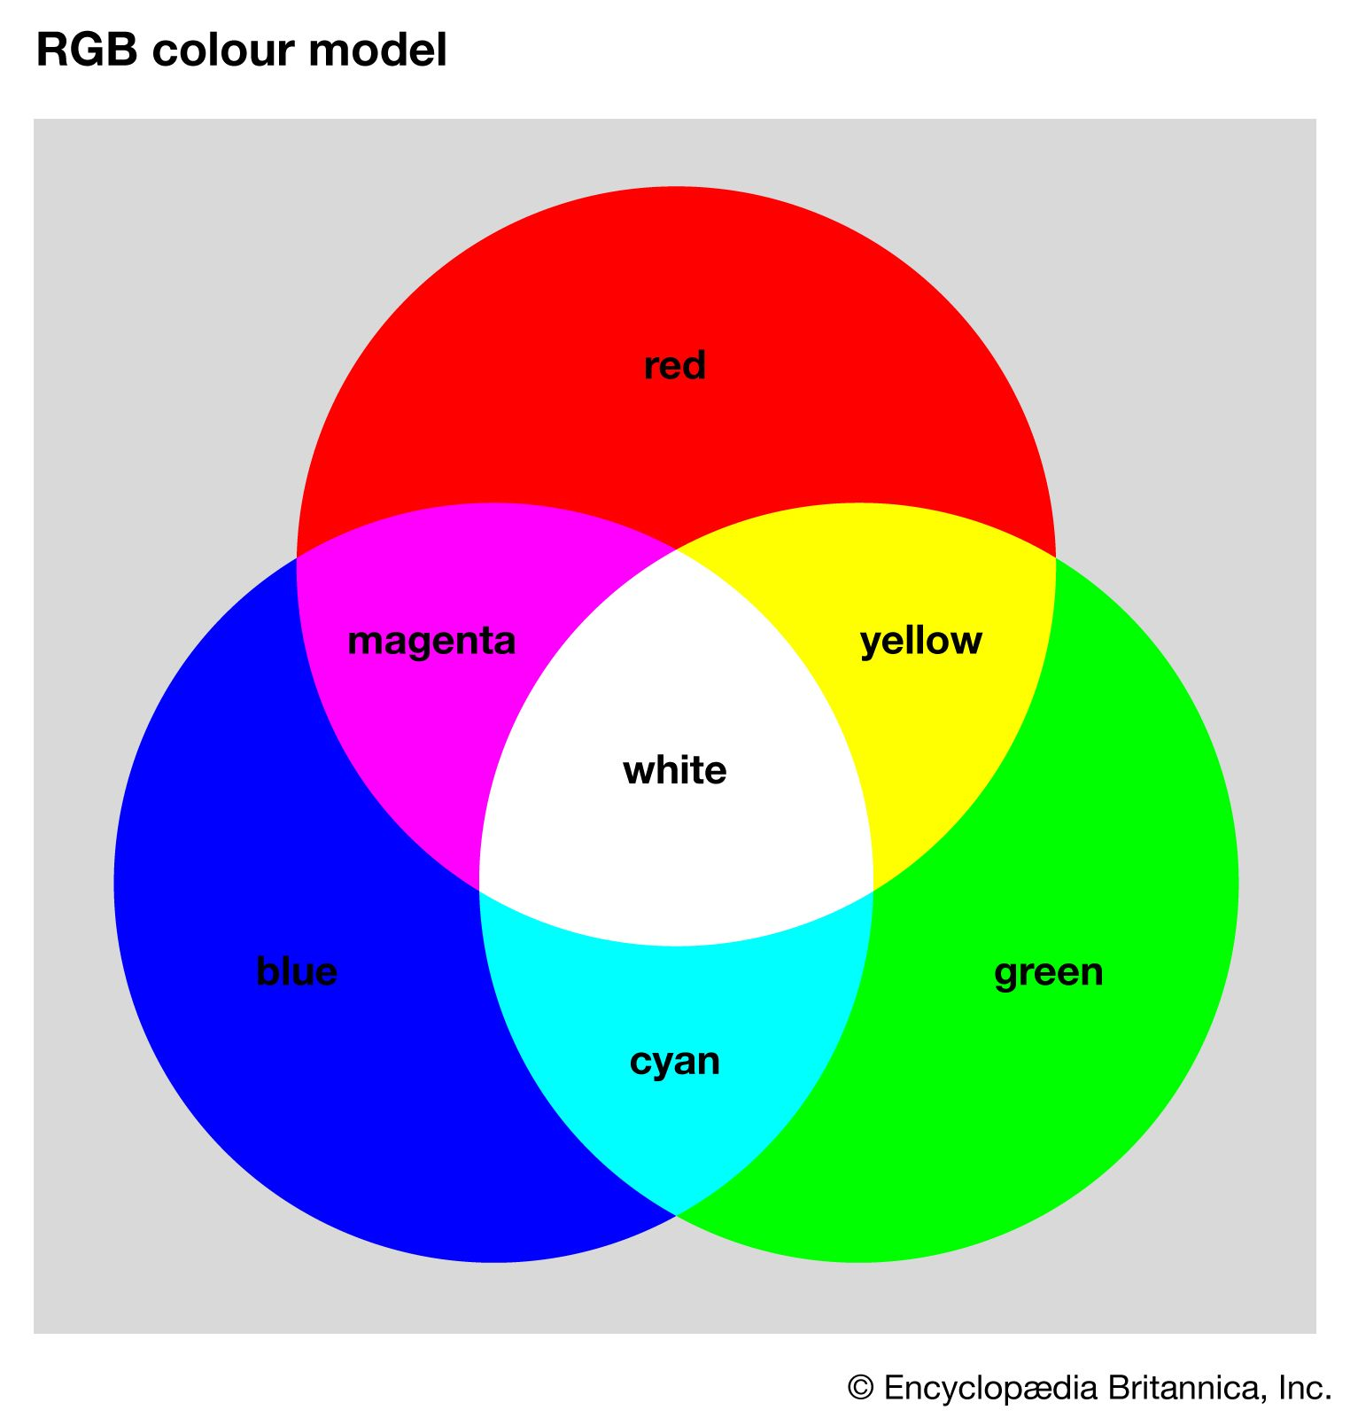
The primary colors are added to produce secondary colors. Red + Blue = Magenta Red + Green = Yellow Blue + Green = Cyan

Slide 21
CMY and CMYK Models:
cyan, magenta, and yellow are the secondary colors of light or, alternatively, they are the primary colors of pigments.
For example, when a surface coated with cyan pigment is illuminated with white light, no red light is reflected from the surface.
That is, cyan subtracts red light from reflected white light, which itself is composed of equal amounts of red, green, and blue light.
equal amounts of the pigment primaries, cyan, magenta, and yellow, should produce black.
In practice, because C, M, and Y inks seldom are pure colors, combining these colors for printing black produces instead a muddy-looking brown.
So, in order to produce true black (which is the predominant color in printing), a fourth color, black, denoted by K, is added, giving rise to the CMYK color model.
The black is added in just the proportions needed to produce true black.

Slide 22
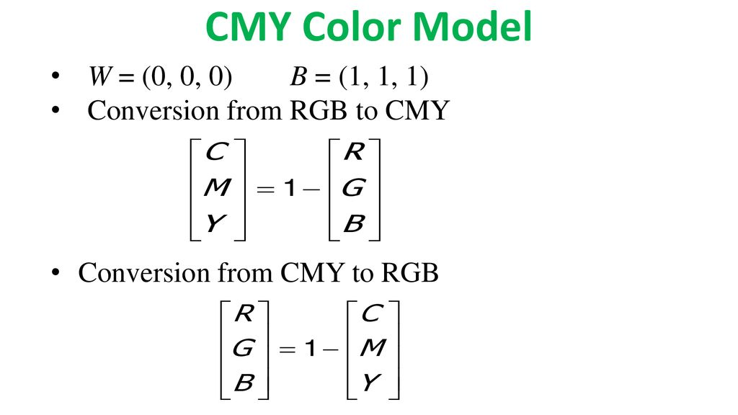

Slide 23
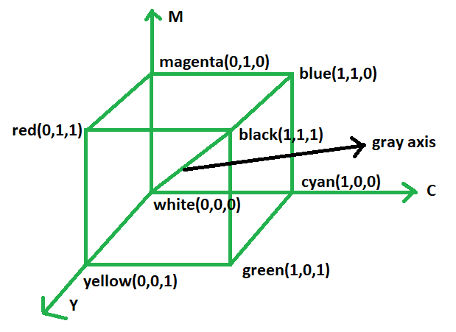
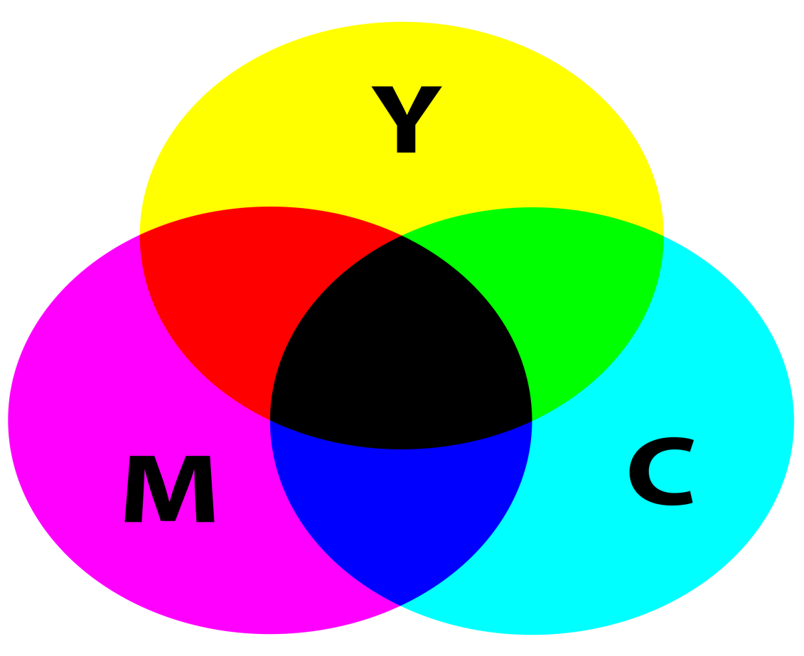
C = 1 - R
M =1 - G
Y = 1 - B

Slide 24
HSI Model:
The HSI color model represents every color with three components: hue (H), saturation (S), intensity (I).
The Hue component describes the color in the form of an angle between [0,360] degrees.
The Saturation component describes how much the color is diluted with white light.
The range of the S varies between [0,1]. The Intensity range is between [0,1] and 0 means black, 1 means white.

Slide 25
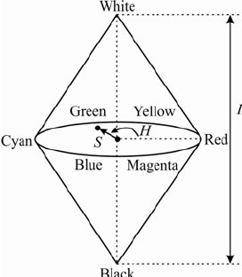

Slide 26
YIQ Model:
YIQ is the most widely color model used in Television broadcasting.
Y stands for luminance part and IQ stands for chrominance part. In the black and white television, only the luminance part (Y) was broadcast.
The y value is similar to the grayscale part. The color information is represented by the IQ part.

Slide 27
Important things to remember:
Chromatic light spans the electromagnetic spectrum from approximately 400 to 700 nm.
Three basic quantities used to describe the quality of a chromatic light source are: radiance, luminance, and brightness.
Radiance is the total amount of energy that flows from the light source, and it is usually measured in watts (W).
Luminance, measured in lumens (Im), is a measure of the amount of energy that an observer perceives from a light source.

Slide 28
Quiz Time:
1. Which color model is used to represent colors as combinations of red, green, and blue?
a) CMYK
b) HSV
c) RGB
d) YIQ
2. The CMYK color model is primarily used in:
a) Computer graphics and digital imaging
b) Printing and publishing industries
c) Television broadcasting
d) Medical imaging

Slide 29
Answers:
1. Which color model is used to represent colors as combinations of red, green, and blue?
a) CMYK
b) HSV
c) RGB
d) YIQ
2. The CMYK color model is primarily used in:
a) Computer graphics and digital imaging
b) Printing and publishing industries
c) Television broadcasting
d) Medical imaging

Slide 30
Overall:
In terms of digital image processing, the hardware-oriented models most commonly used in practice are the RGB (red, green, blue) model for color monitors and a broad class of color video cameras.
The CMY (cyan, magenta, yellow) and CMYK (cyan, magenta, yellow, black) models for color printing.
The HSI (hue, saturation, intensity) model, which corresponds closely with the way humans describe and interpret color.

Slide 31
Thank you!

